Slide 1

Unsupervised Learning
Exploring Clustering and Dimensionality Reduction
https://bit.ly/2PsWKym

Slide 2
1) Recap: Modeling
2) Unsupervised Learning
3) Clustering
4) Dimensionality Reduction
kMeans, Agglomerative, and Density Based Methods
Correlation matrices, forward feature selection, PCA, and LDA

Slide 3
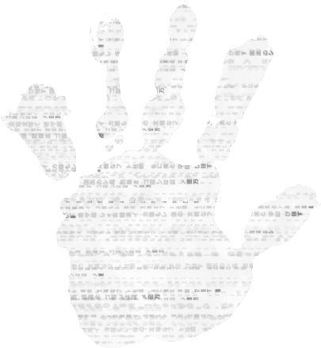
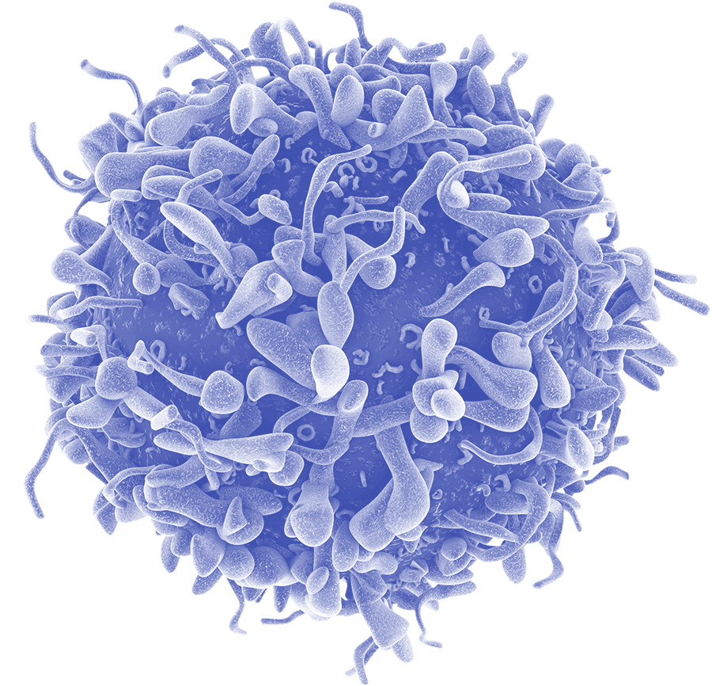
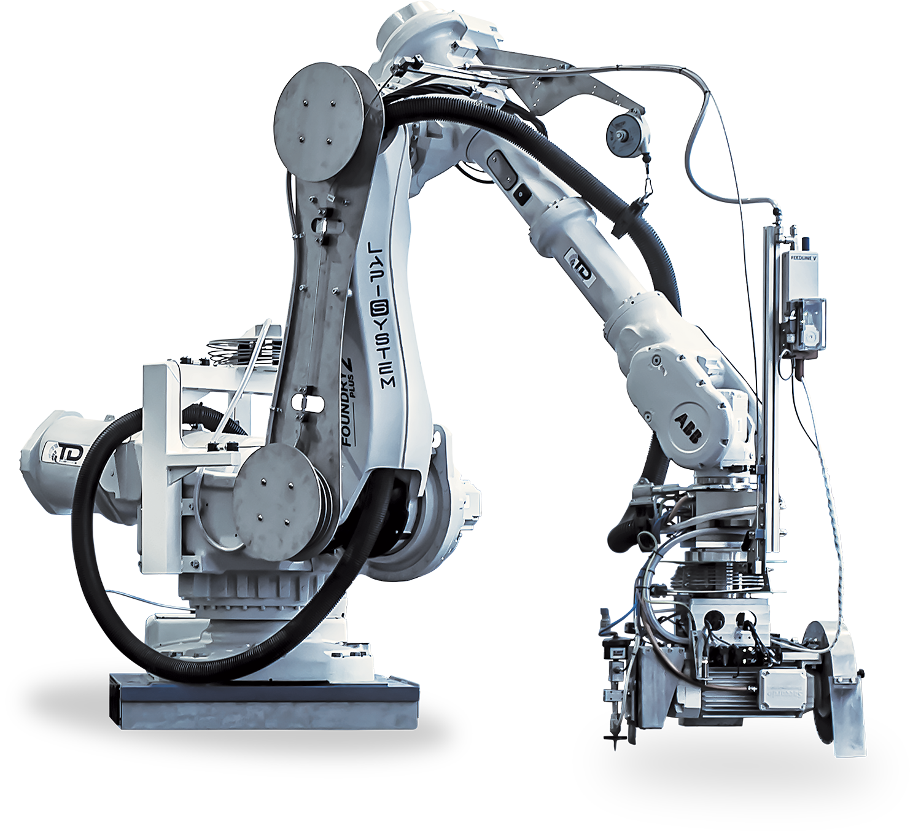


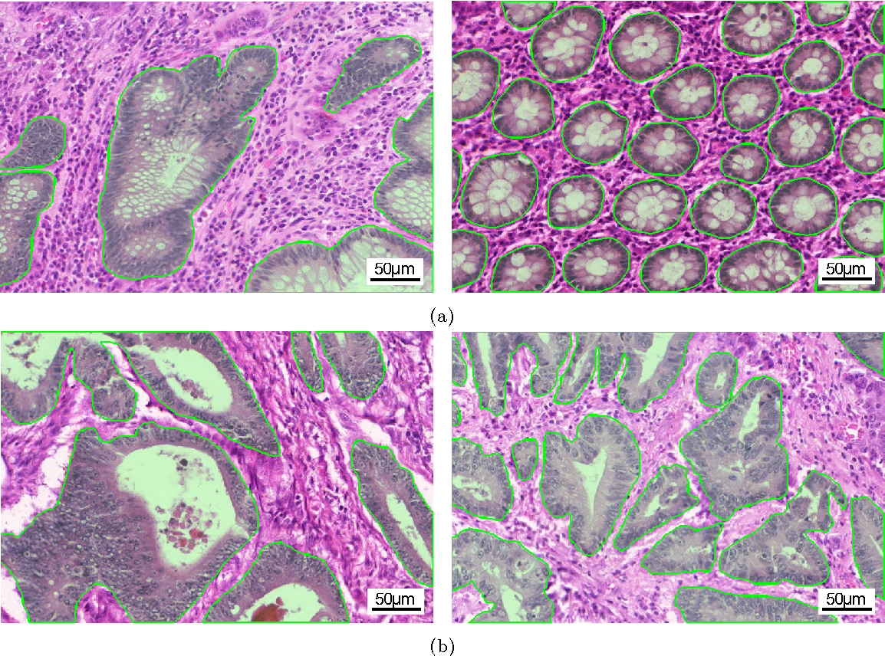
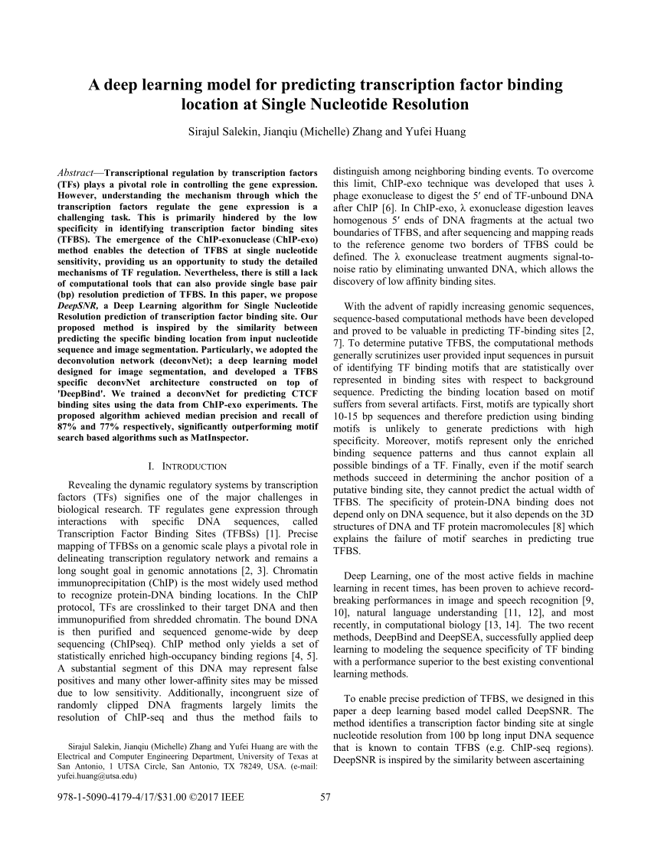


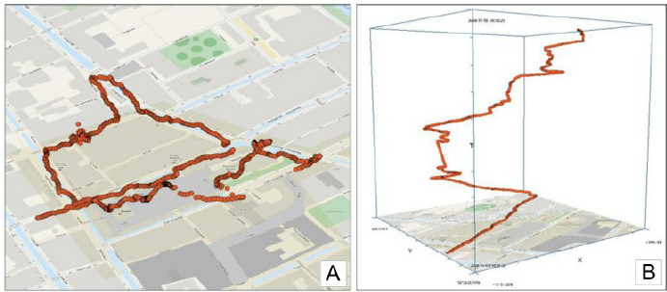
Myth!
Data science, machine learning, deep learning is magic black box
Black Box

Slide 4
But what even is a model?

Slide 5
Three Ways to Consider
Models and Computation
Picture Representation
Decision Boundaries
Mathematical Formulation

Slide 6
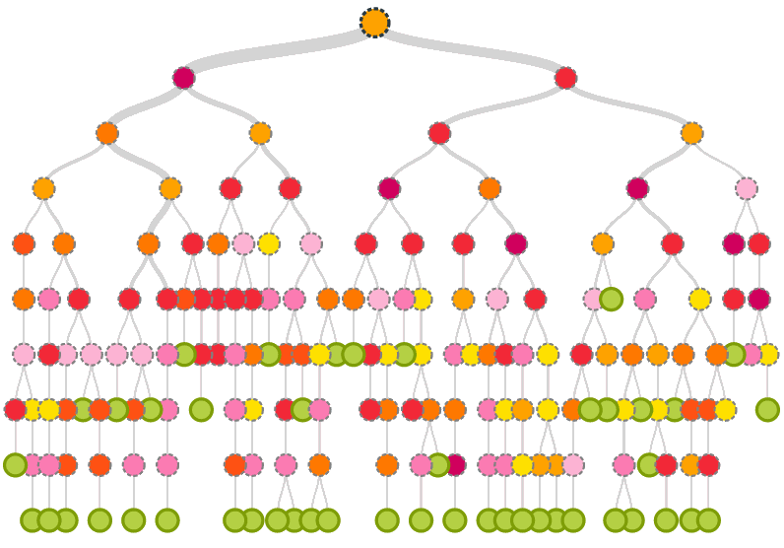
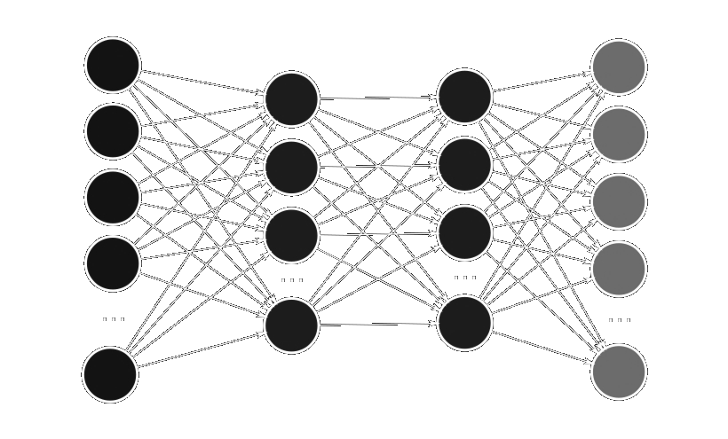
1) Pictorial Representations

Slide 7
2) Decision Boundaries
SVM
Decision Tree
Neural Network

Slide 8
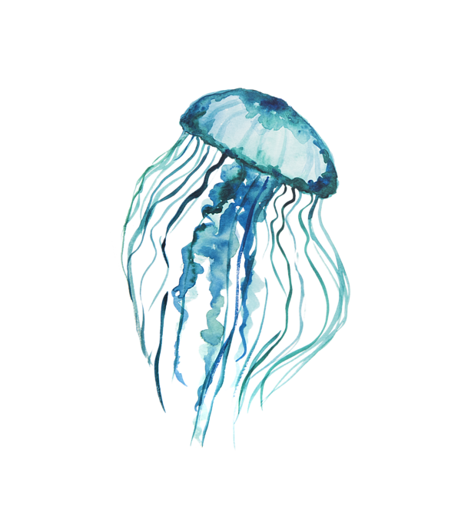
3) Math Formulation
Discover a mapping function representing input output relationships
Example:
y = f(x) + e
f: X → Y
f: X → Y
Image → Label
Jellyfish

Slide 9
Unsupervised Learning
Any guesses to what this means?

Slide 10
Unsupervised Learning
Unlabeled data
Self-Organizing
Extract underlying patterns in the data

Slide 11
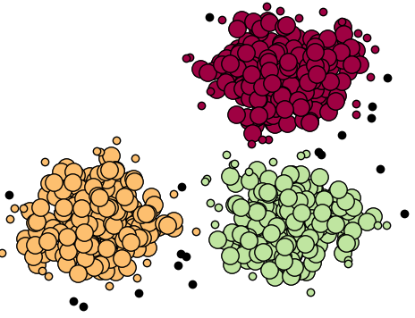
What is clustering?
Unsupervised learning
Group by similarity
Goal:
High intra-cluster similarity
Low inter-cluster similarity

Slide 12









But how do we determine similarity?
No obvious objective function
f(x) = “maximize similarity”
?????
Hot/Cold
Food/Beverage

Slide 13
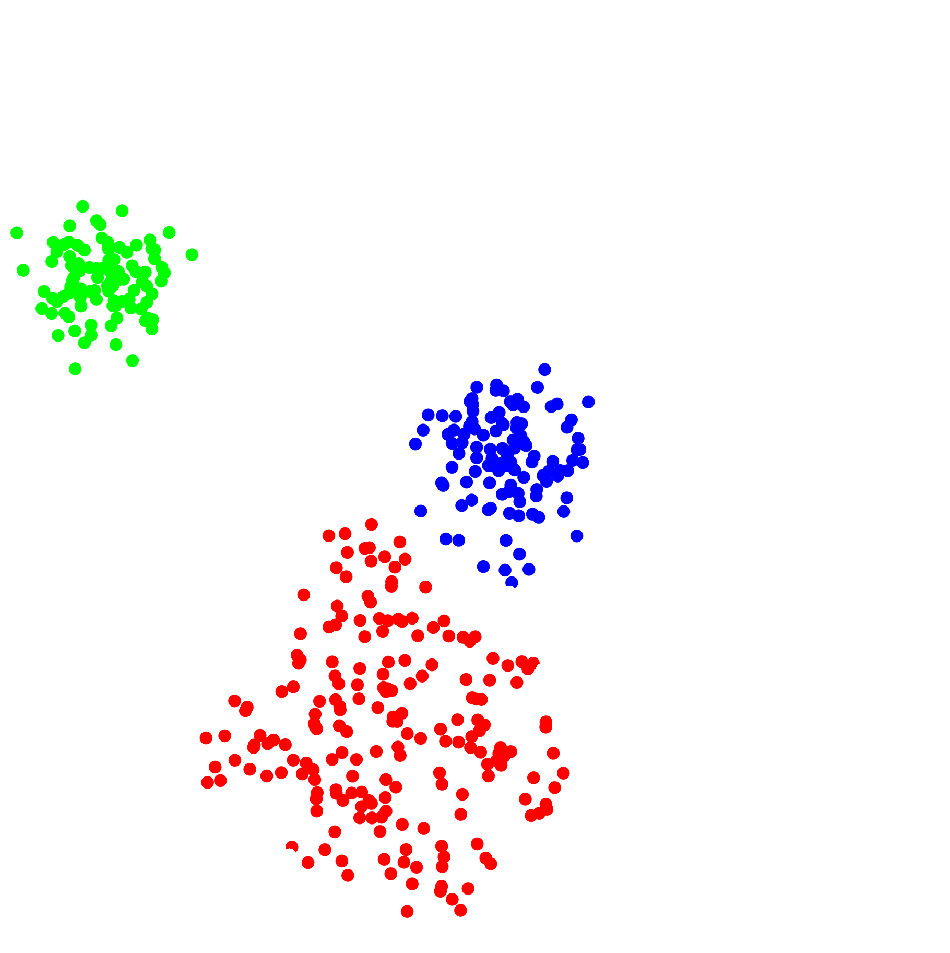
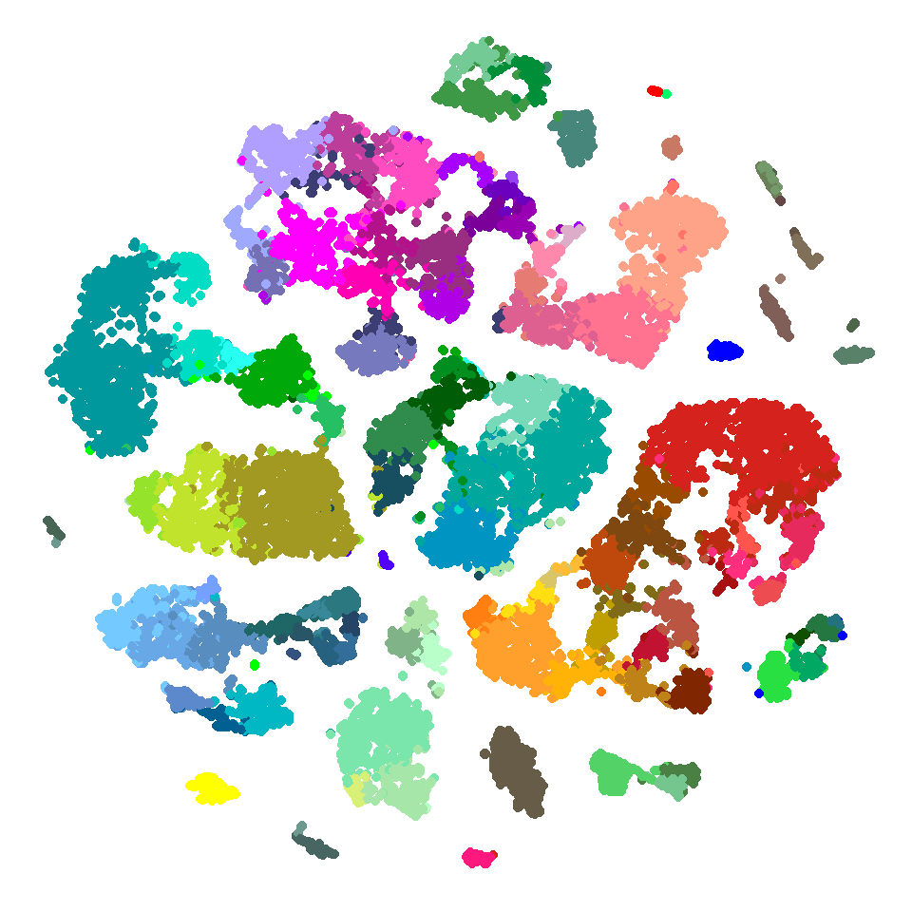
What if divisions not obvious?

Slide 14
Distance Metrics
Euclidian
Manhattan
Minkowski
Cosine Similarity
….

Slide 15

Distance Metrics
Euclidian
Manhattan
Minkowski
Cosine Similarity
….
Notes:
https://subscription.packtpub.com/book/big_data_and_business_intelligence/9781785882104/6/ch06lvl1sec40/measuring-distance-or-similarity

Slide 16




Distance Metrics
Euclidian
Manhattan
Minkowski
Cosine Similarity
….
L1
L2
Notes:
https://subscription.packtpub.com/book/big_data_and_business_intelligence/9781785882104/6/ch06lvl1sec40/measuring-distance-or-similarity

Slide 17
K-Means Clustering

Slide 18
Algorithm
1) Decide on K centers
2) Initialize K centers
3) Assign points to the nearest centers
4) Move center towards mean
5) Recompute distances
6) Reassign clusters
7) Move centers
8) Halt when no change -- Converged!
Notes:
Random initialization popular

Slide 19
Algorithm
1) Decide on K centers
2) Initialize K centers
3) Assign points to the nearest centers
4) Move center towards mean
5) Recompute distances
6) Reassign clusters
7) Move centers
8) Halt when no change -- Converged!
Notes:
Random initialization popular

Slide 20
Algorithm
1) Decide on K centers
2) Initialize K centers
3) Assign points to the nearest centers
4) Move center towards mean
5) Recompute distances
6) Reassign clusters
7) Move centers
8) Halt when no change -- Converged!
Notes:
Random initialization popular

Slide 21
Algorithm
1) Decide on K centers
2) Initialize K centers
3) Assign points to the nearest centers
4) Move center towards mean
5) Recompute distances
6) Reassign clusters
7) Move centers
8) Halt when no change -- Converged!
Notes:
Random initialization popular

Slide 22
Algorithm
1) Decide on K centers
2) Initialize K centers
3) Assign points to the nearest centers
4) Move center towards mean
5) Recompute distances
6) Reassign clusters
7) Move centers
8) Halt when no change -- Converged!
Notes:
Random initialization popular

Slide 23
k-Means Pros and Cons
1) Intuitive
2) Easy to Implement
3) Simple
4) Reasonably effective
1) Must specify K
2) Initialization important
3) Weak with noisy data
4) Searches for elliptical/spherical clusters
5) Memory costs

Slide 24
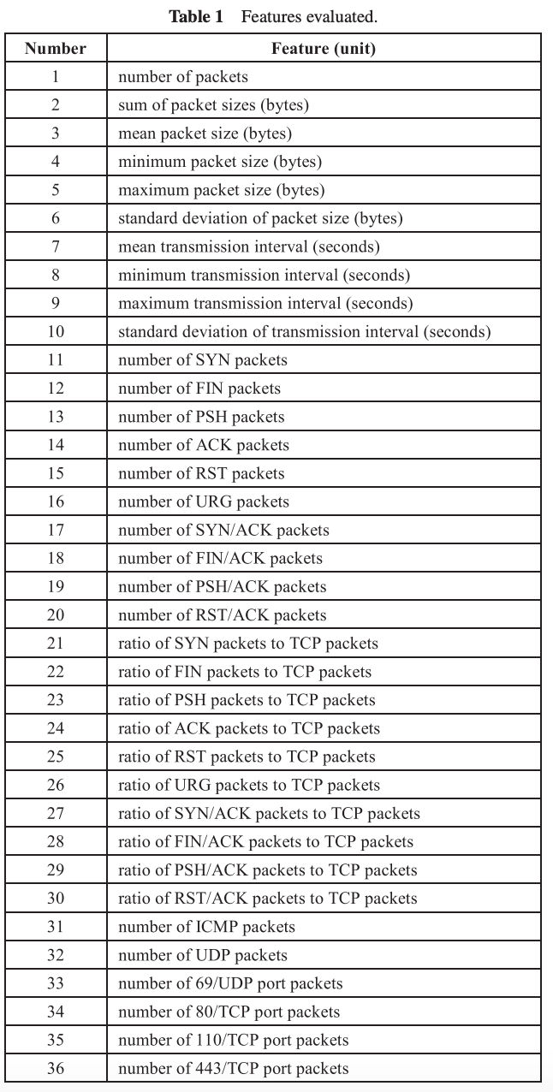
x₁
x₂
x₃
x₄
x₅
...
x₁₉₀
Problem!
What if your data has
too many features?

Slide 25
Dimensionality Reduction

Slide 26
Dimensionality Reduction
?

Slide 27
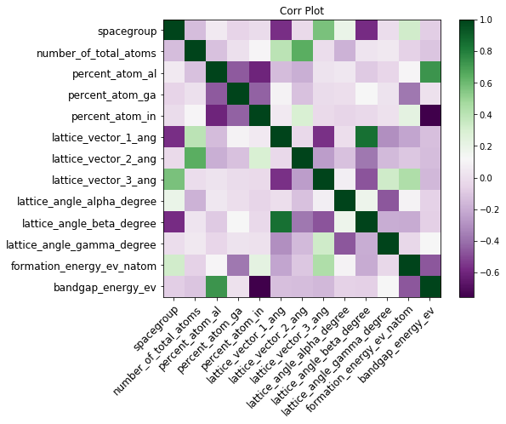
Using Correlation Coefficients

Slide 28
Forward Feature Selection
Steps:
Iterate through all features
Select most informative feature
Keep it
Iterate through all other features
Select best compliment
Iterate through remaining features
Select best compliment
Terminate at threshold

Slide 29
Forward Feature Selection
Steps:
Iterate through all features
Select most informative feature
Keep it
Iterate through all other features
Select best compliment
Iterate through remaining features
Select best compliment
Terminate at threshold
2
R

Slide 30
PCA
Intuition
Use variation to… Redefine our axis!
New coordinate system

Slide 31
PCA
Intuition
Use variation to… Redefine our axis!
New coordinate system
Notes:
Calculate the covariance/correlation matrix
Calculate the eigenvectors and the eigenvalues of the covariance matrix
Choose principal components : eigenvectors are ordered by eigenvalues from the highest to the lowest. The number of chosen eigenvectors will be the number of dimensions of the new data set. eigenvectors = (eig_1, eig_2,…, eig_n)
compute the new dataset :

Slide 32
PCA
Intuition
Use variation to… Redefine our axis!
New coordinate system
PC2
PC1

Slide 33
PCA
** Mathematical Foundations **
Compute Covariance/Correlation
Matrix
Find Eigenvectors/Eigenvalues
Orthogonality
Select PCs
Transform Data
PC2
PC1

Slide 34
PCA
Principal Components
Linear combos of features
Ranked by importance
Key Take-Away:
Not really “feature selection”
Feature “generation”?
PC1 > PC2 > PC3 > PC4 > PC5 > PC6 > PC7 …. PCn
Ex. Select top N?

Slide 35
Extra Materials!
See supplementary Slides for Investigation of:
Hierarchical Clustering DBSCAN

Slide 36
Questions?
Survey: go.hack.gt/workshop-unsupervisedlearning

